Slide 1



Faculdade de Tecnologia da Zona Leste 8° Encontro de Gestão e Tecnologia
SAFEVIEW
Blind Spot Reduction System for Large Vehicles

Slide 2
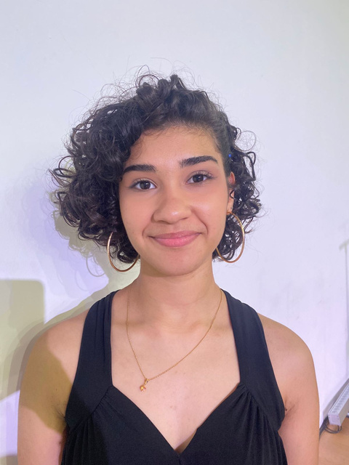
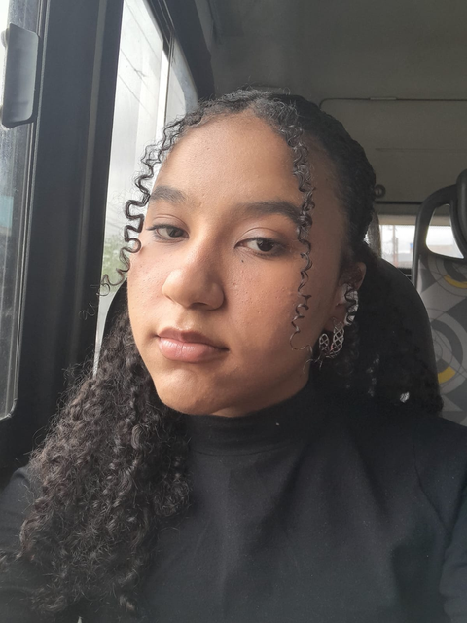
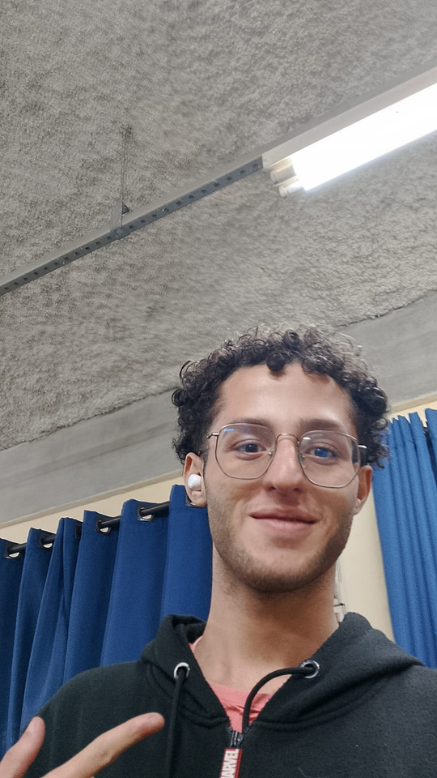
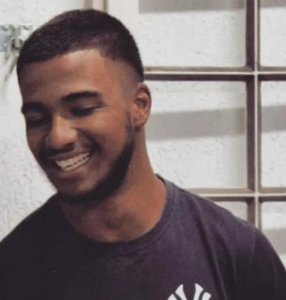

GROUP MEMBERS
ESTER RODRIGUES SOARES
GABRIELLY NASCIMENTO BENTO
GUSTAVO HENRIQUE RIBEIRO DA SILVA
JHONATA ALVES DO NASCIMENTO

Slide 3


OUR THEME
WHY A BLIND SPOT REDUCTION SYSTEM?
Trucks pose serious risks on the road due to limited visibility of pedestrians, cyclists, and smaller vehicles.
This work aims to provide solutions that enhance safety and reduce accidents caused by blind spots.

Slide 4
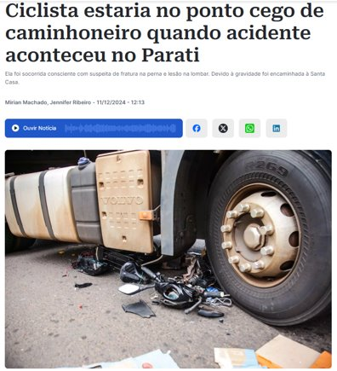
JUSTIFICATION
Blind spot risk: large vehicles remain dangerous in urban traffic.
Serious impact: over 3,000 pedestrian and cyclist deaths between 2013–2023; 312 in 2024 in Brazil alone.
Tech limitations: cameras and sensors still uncommon, especially in older trucks and small transport companies.
Source: midiamax, 2024.

Slide 5

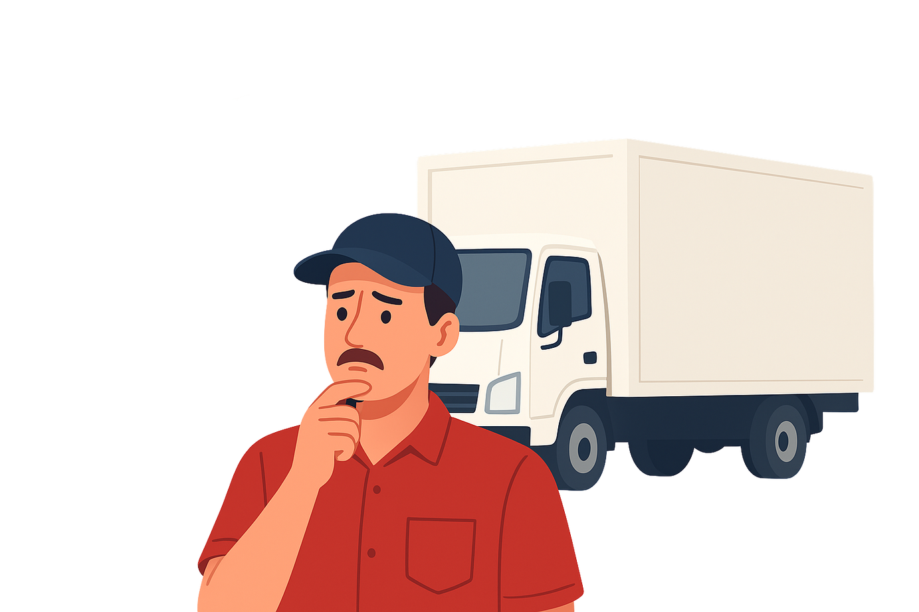
SEARCH PROBLEM
High costs: Expensive tools deter investment due to financial risks.
Financial risk: Uncertainty about returns leads truckers to avoid technology.
Tech distrust: Less tech-savvy truckers fear difficulties with digital solutions.

Slide 6

GENERAL OBJECTIVE AND SPECIFIC OBJECTIVES
Develop an IoT system with an efficient app to support blind spot monitoring in box trucks and improve road safety.
Implement a monitoring system with sensors and cameras.
Ensure compatibility with different truck models.
Guarantee easy installation and operation.

Slide 7


QUALITATIVE METHODOLOGY
Qualitative changes do not come from quantitative ones, but replace them. (MARCONI and LAKATOS, 2017).
RESEARCH METHODOLOGY
Based on box truck accidents and visual impairments.
less quantity more quality

Slide 8



CET (2019) and PRF (2024) provide key insights into traffic safety and monitoring in Brazil. Complementing these perspectives, Oliveira (2021) highlights how the Internet of Things (IoT) enables connected devices and smarter solutions for transportation and road safety.
Figure 1 - CET
Figure 2 - PRF
Figure 3 - IoT book
CONCEPTUAL FOUNDATION
Source: cetsp.com.br, 2025​.
Source: gov.br, 2023​.
Source: Amazon.com.br, 2025​.

Slide 9
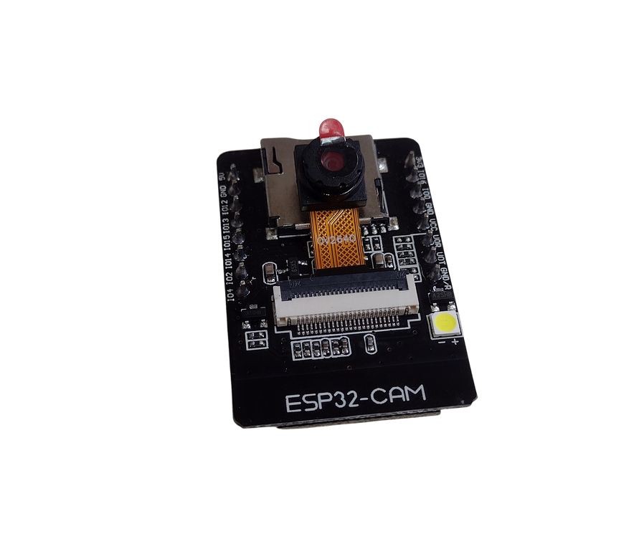
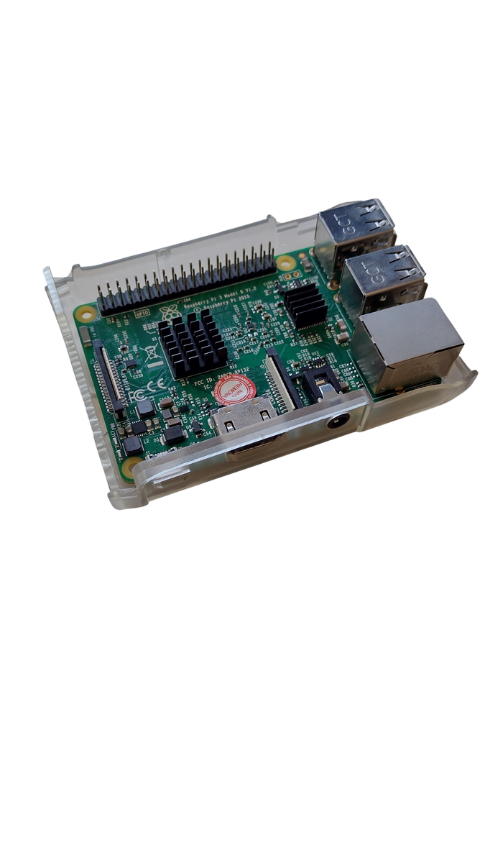


TECHNOLOGIES
Figure 4 - ESP32-CAM​
Figure 5 - Raspberry Pi​
Source: Own authorship, 2025.​
Source: Own authorship, 2025.​
Figure 6 - Logo Python​
Figure 7 - Logo C + +
Source: Python.org,
2025.​
Source: Microsoft Community,
2025.​

Slide 10
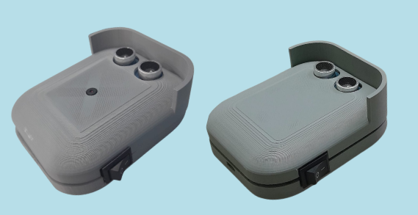
PROTOTYPE DEVICES

Slide 11





TECHNOLOGIES
Figure 8 - React Native
Figure 9 - CSS​
Figure 10 - Firebase
Source: React Native, 2025.​
Source: Ultimate Courses, 2025.​
Source: Firebase, 2025.​
Figure 11 - Figma
Figure 12 - UML
Source: Figma, 2025.​
Source: Orbus Software, 2025.​

Slide 12
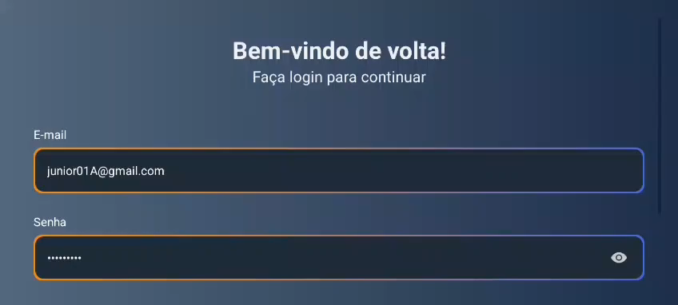

Slide 13
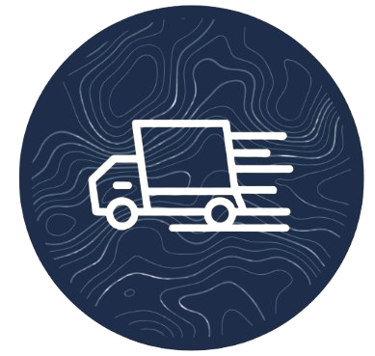
KEY CONSIDERATIONS
Truck drives are the backone of logistics
SafeView was created to support the drivers and offering a solution that meets their real needs.

Slide 14
REFERENCES
Relatório Anual de Acidentes (CET). Available at: <https://www.cetsp.com.br/media/1058619/2019.pdf>. Access in: 24 august, 2025.
midiamax. Ciclista estaria no ponto cego de caminhoneiro quando acidente aconteceu no Parati. Available at:https://midiamax.uol.com.br/policia/transito/2024/ciclista-estaria-no-ponto-cedo-de-caminhoneiro-quando-acidente-aconteceu-no-parati/. Access in: 23 may. 2025.
MACRONI E LAKATOS
Internet das Coisas com ESP8266, Arduino e Raspberry Pi - 2ª Edição. Author: Sérgio de Oliveira.
Introdução a Programação em Python - 3ª Edição. Author: Nilo Ney Coutinho Menezes.
PROGRAMAÇÃO EM C++: ALGORITMOS, ESTRUTURAS DE DADOS E OBJETOS. Author: Luis Joyanes Aguilar
React Native Desenvolvimento de aplicativos mobile com React. Authors: Diego Martins de Pinho, Bruna Escudelario
Firebase (Google). Available at: <https://firebase.google.com/>. Access in: 24 august, 2025.
EBAC ONLINE. Figma. Available at: <https://ebaconline.com.br/>. Access in: 24 august, 2025.
UML 2 - Uma Abordagem Prática. Author: Gilleanes T. A. Guedes

Slide 15

THANK YOU VERY MUCH for your attention!
REMEMBER: SafeView - revealing what the eyes don't see.

